Slide 1
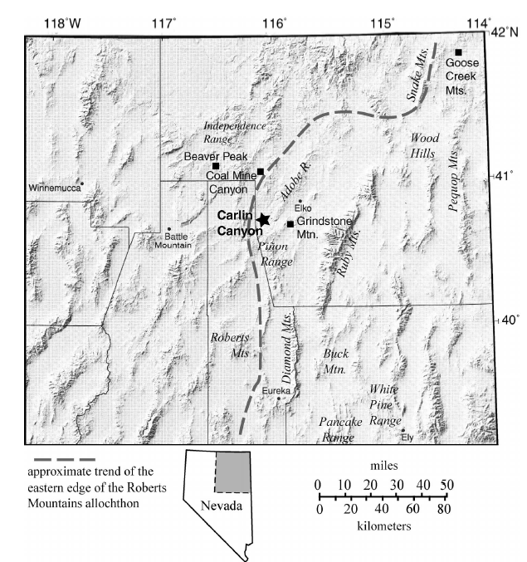
Late Paleozoic tectonism in Nevada: Timing, kinematics, and tectonic significance
James Trexler, Patricia Cashman, Walter Snyder, Vladimir Davydov, 2004
Mapping at Carlin Canyon shows undeniable evidence of late Paleozoic (Middle Pennsylvanian- Early Permian) contractional deformation.
This deformation matters because it impacts how we think the western margin of North America evolved

Slide 2
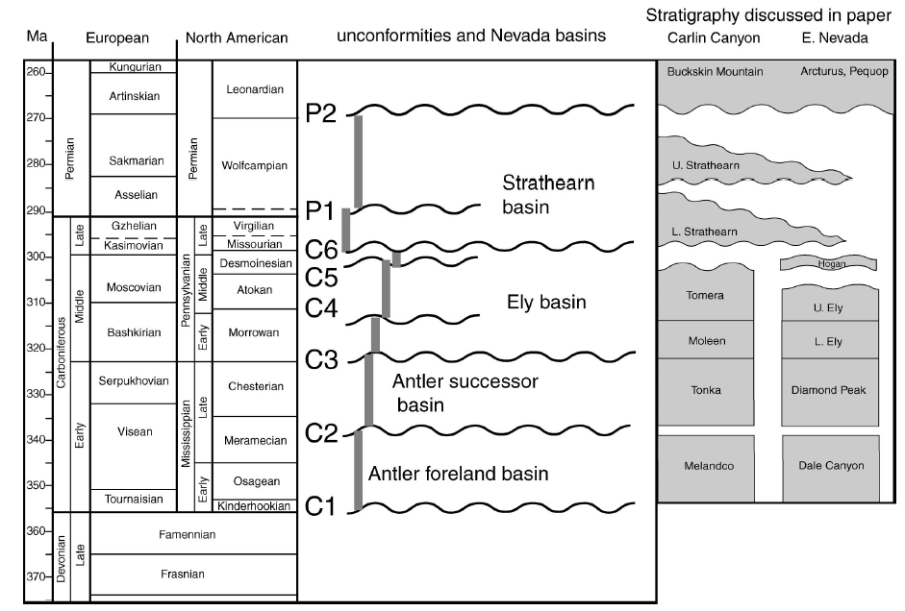
Reasons for the present study
Evidence for late Paleozoic deformation has long been recognized, but is generally overlooked when discussing the evolution of western North America
Paleozoic deformation that has been recognized has been chalked up to being ‘local’ and not worth further investigation.
The authors believe that, given the number of ‘local’ deformation events, that it is worth investigating whether there is one or more regional events that tie these deformational events together

Slide 3
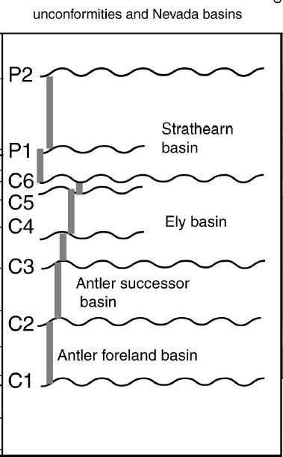
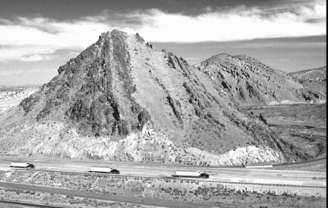
Geologic Relations at Carlin Canyon
Looking north
Mapping reveals 3 angular, and 1 not angular, unconformities in the upper Paleozoic stratigraphic section
C2- angular unconformity, Mississippian in age, cuts down section to the west
C6- cuts down section to the west, originally recognized by Dott (1955) as evidence for Pennsylvanian deformation. Deformation consists of thrust faults and macroscopic overturned folds, northeast plunging. Records contraction
P1- cuts down section to the east, Permian deformation. Expresses as open, upright folds, northeast plunging
P2- cuts down section to the east. Regional scale unconformity
C2
C6

Slide 4
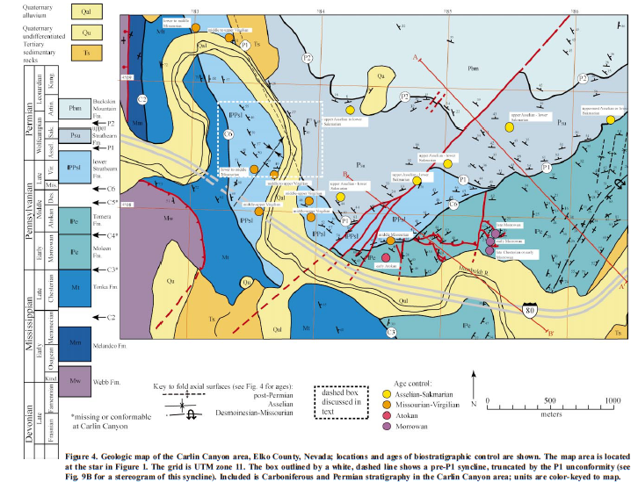

Slide 5
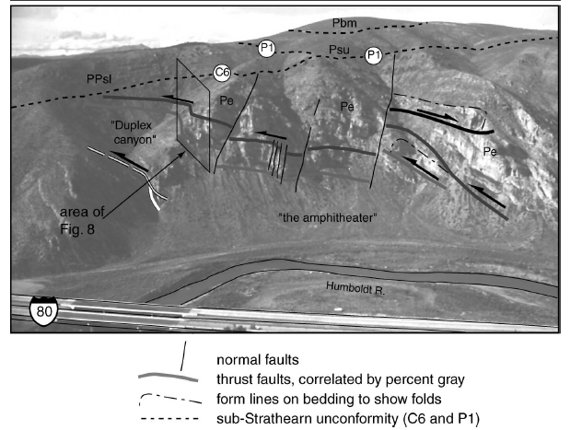
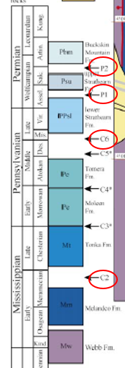
Kinematics of Pennsylvanian and Permian Deformations
C2- pre-late Mississippian. Marked by Melandco Fm below Tonka Fm above. Geometry not defined at Carlin Canyon but is regional in extant.
C6- post-early Middle Penn. Juxtaposes Tonka, Moleen, and Tomera Fms below the Strathearn Fm. Overturned folding and imbricate thrusting. Northwest thrusting evidence in ‘Duplex Canyon’

Slide 6
Kinematics of Pennsylvanian and Permian Deformations
P1- post-late Pennsylvanian. Expresses as an unconformity separating lower Strathearn Fm below and upper Strathearn above exhibited as upright open folds.
P2- post-early Early Permian but pre-late Early Permian. Separates upper Strathearn Formation below from Buckskin Mtn Fm above. Major unconformity at regional scale

Slide 7
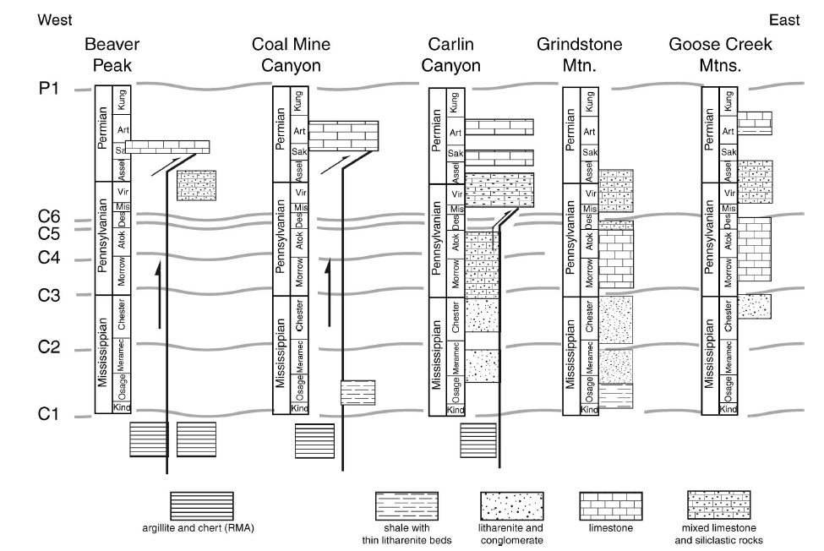

Slide 8
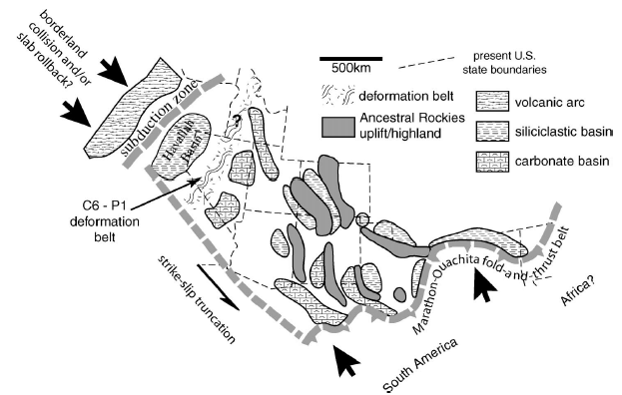
Discussion
Authors suggest much of the deformation that is currently attributed to the Antler orogeny could actually be Pennsylvanian/Permian, especially within Antler allochthon
During Penn-Perm time several plate boundaries could have affected deformation in this region
There must have been an active orogenic belt in the proto-Great Basin, given the well constrained deformation at Carlin Canyon.
Key class take-aways:
Paleozoic deformation is much more widespread than is recognized in the literature
Deformation at Carlin Canyon took place between the Antler and Sonoma orogenies

